Slide 1
30th Colloquium of European Parishes in Lviv, 27 July – 1 August, 2019
Youth Program

Slide 2
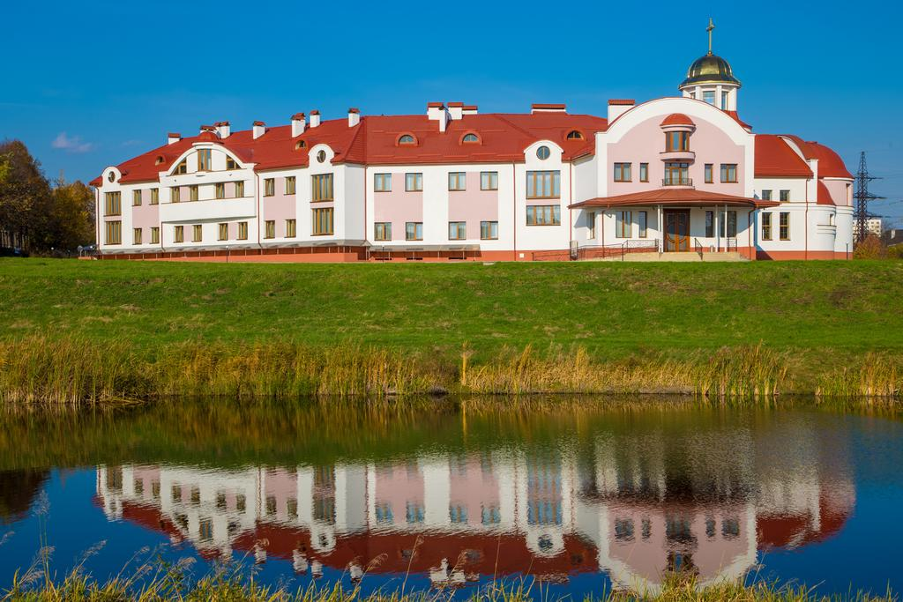
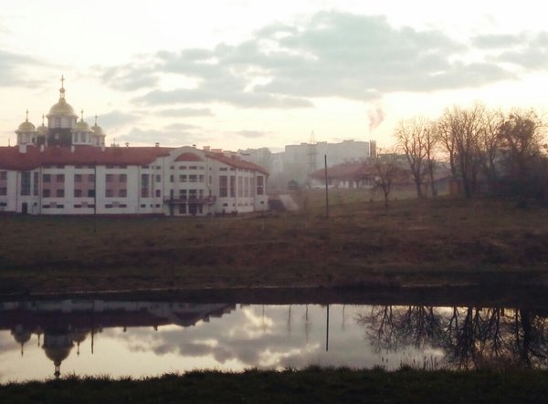
Saturday, July 27
14:00 18:00 19:30 20:30 21:30 | Registration Mass at the Parish of the Seminary, presided by the Archbishop, Welcome message of the Ukrainian group and the CEP President (10 min) Meeting of the permanent experts with animators / group secretaries/ organizing committee. Information time for the participants Dinner + evaluation Informal meeting (for each national group – possibility}. Every night different nations will be sharing food and drink (e.g. Malta+Italy) – should be decided in advance “get together” around the fire by the lake & music

Slide 3
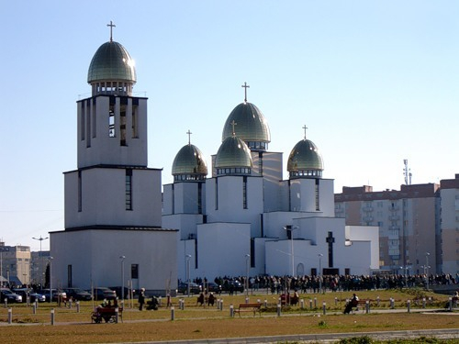
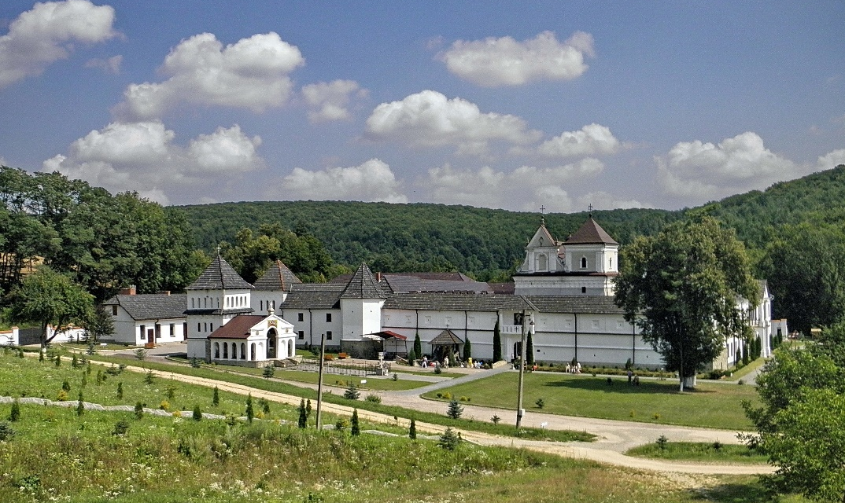
Sunday, July 28
8:30 - 10:00 10:00 11:00 12.30 13:00 – 14:00 14:30 15.30 19.30 20:30 21:15 | Breakfast Departure time for the parish of the Nativity of Virgin Mary Holy Mass (the Nativity of Virgin Mary Church) – big parish nearby which was visited by the Pope John Paul II in 2001 Return (by foot) Lunch Departure time for the Univ monastery Start of Cultural program. Tour to Univ monastery (60 km from Lviv) Presentation of the Church and the country, Ukrainian society Refreshment at the monastery Return Dinner + evaluation Evening in the city. (themed cafés) / free time

Slide 4
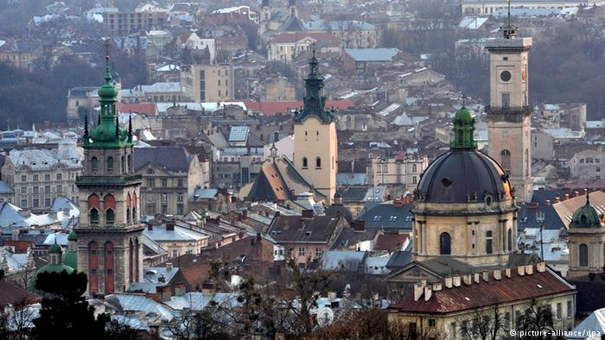
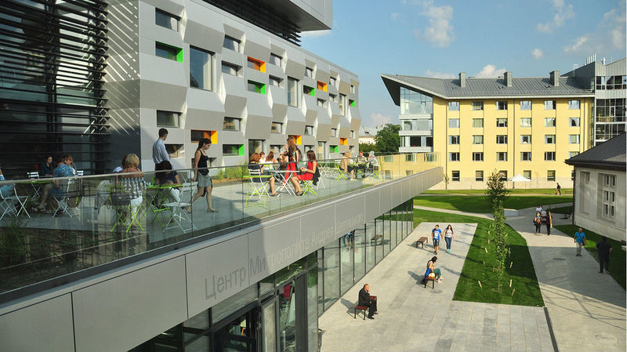
Monday, July 29
7:00 - 8:30 8:30 8:45 9:15 12:30 13:00 14:00 16:00 18:00 20:30 21:15 | Breakfast Information. General introduction to CEP – Antonio Cassar (the President of CEP) Time of departure for the city tour City tour game (ending with visiting St. Peter & Paul Jesuit church 1 topic – Pope Francis, who is and what is his vision. Liturgy) Come back Lunch Visit to UCU, Sheptytskyi Center. Meeting with local Christian youth. Prayer with Choir Taize-Lviv Masterclass “Icon on glass” together with adults Dinner + evaluation Time of departure to the High castle / free time

Slide 5
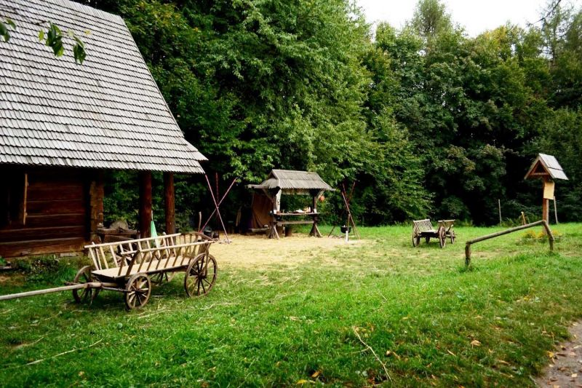
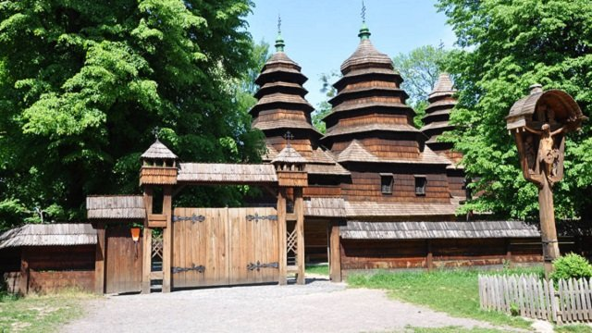
Tuesday, July 30
7:00 – 8:30 8:30 8:45 09:00 13:30 16:00 20:00 21:00 | Breakfast Fil rouge Departure to the open air Museum Klymentiy Sheptytskyi Holy Liturgy at the John the Baptist church Lunch in the open air (Plan B) Visit to different parishes. The youths will be divided according to the different languages. A snack or dinner will be provided by the parish. Return + evaluation Discussion about the experience of the youths. Preparing the presentation for the next day. Preparing a flash-mob or a concert for the last evening.

Slide 6
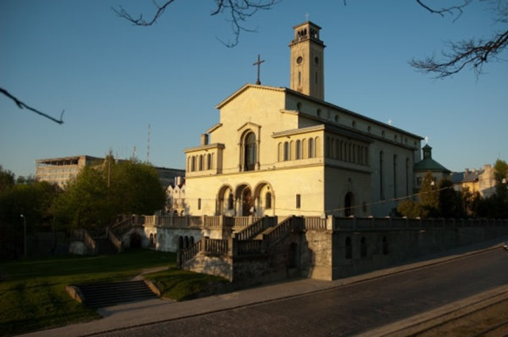
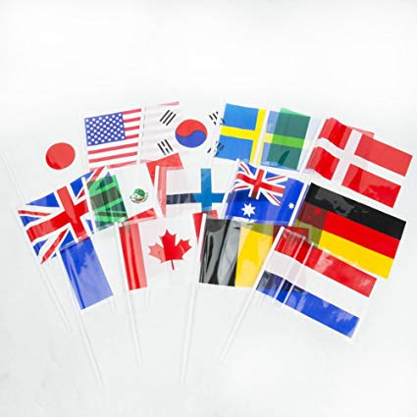
Wednesday, July 31
7:00 - 8:30 8.30 9:00 10:00 11:00 11:45 12:00 13:00 14:30 15:00 18:00 19:00 | Breakfast Fil rouge Conference. 3 topic. “Who will help us to live as Christians in today’s Europe?” Held by Yuriy Pidlisnyy. Contribution of young people Next colloquium presentation (2021) Evaluation form Holy Mass (Thanksgiving) Lunch Departure to the Salesian Parish A visit to the Salesian Parish Return + evaluation Dinner - Party of Nations

Slide 7
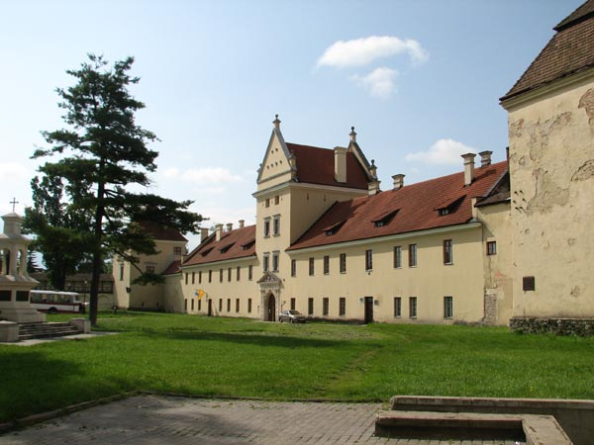
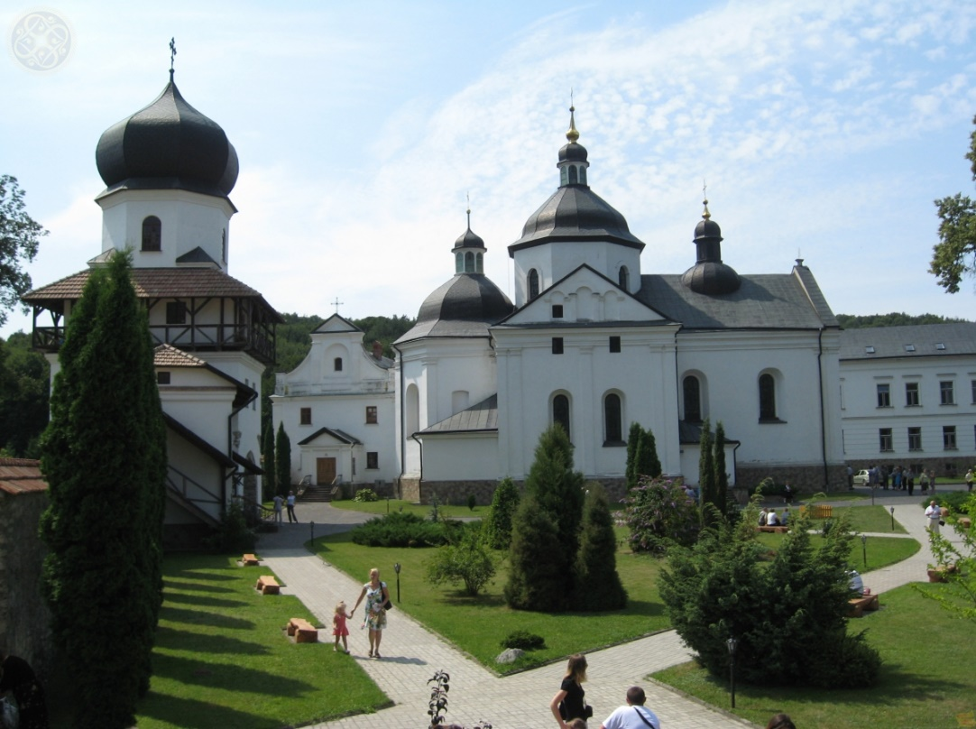
Thursday, August 1
7:00 – 8:15 Breakfast and farewell.
9:00 Optional cultural program – visit to the ancient city of Zhovkva and Krehkiv monastery

